Slide 1

ALL AT A GLANCE

Slide 2
01
02
03
TABLE OF CONTENTS
INTRODUCTION
VISION & MISSION
EVOLUTION MATRIX

Slide 3

01
INTRODUCTION

Slide 4

INTRODUCTION
Discover the best of online shopping with ShopLinker, your one-stop platform for finding all your favorite shopping websites. Whether you're looking for the latest fashion trends, tech gadgets, home essentials, or unique gifts, ShopLinker has you covered.

Slide 5
02
VISION & MISSION

Slide 6
VISION & MISSION
VISION
MISSION
ShopLinker simplifies online shopping with personalized searches, exclusive deals, and curated links, making it your go-to platform for smart shopping and trusted retailers.
To be the leading online shopping aggregator, connecting consumers with the best and most diverse selection of shopping websites worldwide, simplifying the shopping experience through innovation and excellence.

Slide 7
03
EVOLUTION MATRIX

Slide 8




EVALUATION MATRIX
VALIDATION & ERROR HANDLING
COMPLEXITY UNDERSTANDING
UNIT TESTING (BUYING FUNCTIONALITY)
SECURITY IMPLEMENTATION
UNIT TESTING (SELLING FUNCTIONALITY)

Slide 9
VALIDATION & ERROR HANDLING
COMPLEXITY UNDERSTANDING
UNIT TESTING (BUYING FUNCTIONALITY)
SECURITY IMPLEMENTATION
UNIT TESTING (SELLING FUNCTIONALITY)
FrontEnd
BackEnd
Dynamic DOM Manipulation
Data Persistence with LocalStorage
Event Handling
UI/UX Considerations
API Integration (Search)
Data Storage (Published Books)
Authentication and Authorization
Payment Processing

Slide 10
EVALUATION MATRIX
VALIDATION & ERROR HANDLING
COMPLEXITY UNDERSTANDING
UNIT TESTING (BUYING FUNCTIONALITY)
SECURITY IMPLEMENTATION
UNIT TESTING (SELLING FUNCTIONALITY)

Slide 11
VALIDATION & ERROR HANDLING
UNIT TESTING (BUYING FUNCTIONALITY)
SECURITY IMPLEMENTATION
COMPLEXITY UNDERSTANDING
UNIT TESTING (SELLING FUNCTIONALITY)
Cross-Site Scripting
Third-Party Libraries
Data Validation
Local Storage Manipulation

Slide 12
EVALUATION MATRIX
VALIDATION & ERROR HANDLING
COMPLEXITY UNDERSTANDING
UNIT TESTING (BUYING FUNCTIONALITY)
SECURITY IMPLEMENTATION
UNIT TESTING (SELLING FUNCTIONALITY)

Slide 13
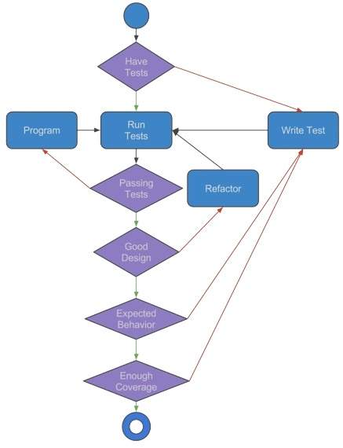
VALIDATION & ERROR HANDLING
UNIT TESTING (SELLING FUNCTIONALITY)
COMPLEXITY UNDERSTANDING
UNIT TESTING (BUYING FUNCTIONALITY)
SECURITY IMPLEMENTATION
Sell funtionality : The "Sell" option provides students with a platform to list their used textbooks for sale. It's a chance to recoup some of their investment while helping fellow students save money on essential course materials.

Slide 14
EVALUATION MATRIX
VALIDATION & ERROR HANDLING
COMPLEXITY UNDERSTANDING
UNIT TESTING (BUYING FUNCTIONALITY)
SECURITY IMPLEMENTATION
UNIT TESTING (SELLING FUNCTIONALITY)

Slide 15
VALIDATION & ERROR HANDLING
UNIT TESTING (BUYING FUNCTIONALITY)
COMPLEXITY UNDERSTANDING
UNIT TESTING (SELLING FUNCTIONALITY)
SECURITY IMPLEMENTATION
Buy funtionality : The "Buy" button empowers students to conveniently purchase products listed by their peers. It's a gateway to affordable course materials, fostering a sharing economy

Slide 16
EVALUATION MATRIX
VALIDATION & ERROR HANDLING
COMPLEXITY UNDERSTANDING
UNIT TESTING (BUYING FUNCTIONALITY)
SECURITY IMPLEMENTATION
UNIT TESTING (SELLING FUNCTIONALITY)

Slide 17
VALIDATION & ERROR HANDLING
UNIT TESTING (BUYING FUNCTIONALITY)
COMPLEXITY UNDERSTANDING
UNIT TESTING (SELLING FUNCTIONALITY)
SECURITY IMPLEMENTATION
API Integration (Search): The project demonstrates the ability to integrate with external APIs (e.g., the book search API) to fetch and display relevant data, enhancing the functionality of the application.
LocalStorage Integration: The use of localStorage showcases the ability to integrate browser storage mechanisms to persist data locally, providing a seamless user experience even when the user refreshes or closes the page.
UI/UX Integration: The project combines multiple user interface elements (search bar, buttons, forms, book listings) and user interactions (searching, selling, buying) into a cohesive user experience. This demonstrates a strong understanding of how different components work together to create a functional and user-friendly application.

Slide 18

THANK YOU
P Sudheer Varma VU21CSEN0300376
Puram.Avinash VU21CSEN0101554
P.Avinash VU21CSEN0300511
6
N.Lokesh Reddy. VU21CSEN0100088
D.Sanjay VU21CSEN0300109
P.Rashmita VU21CSEN0100094

